Slide 1
Programming 101 Day 1
Javascript Intro

Slide 2
Outline
Introduction to Javascript
Data types
Function
Event

Slide 3
Introduction to Javascript

Slide 4
JavaScript is the Programming Language for the Web
JavaScript can update and change both HTML and CSS
JavaScript can calculate, manipulate and validate data

Slide 5
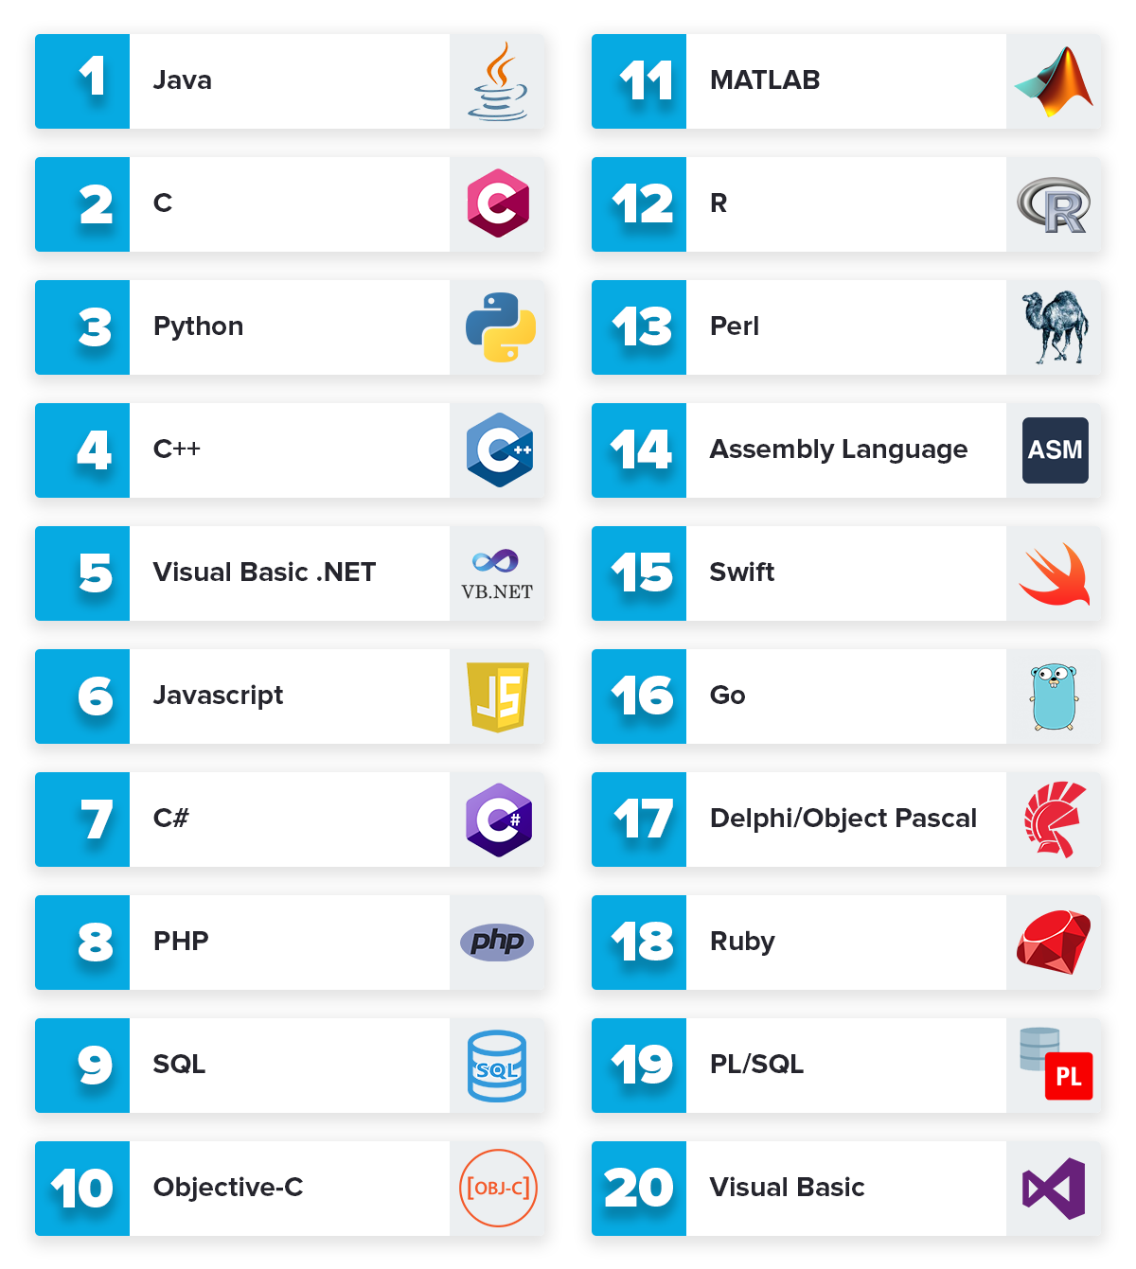
About JS
One of the most In-Demand programming language

Slide 6




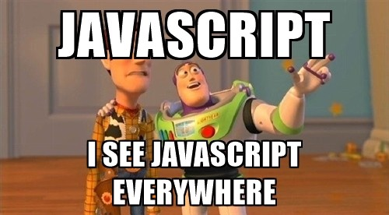

Slide 7
Let’s start!

Slide 8
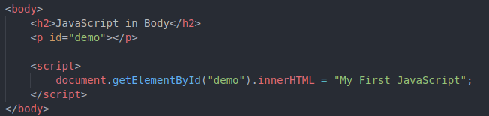
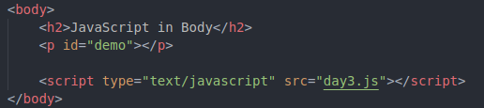
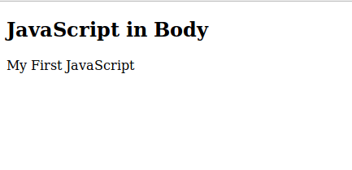
How to use Javascript

Slide 9

JavaScript variables can hold many data types: numbers, strings, objects and more

Slide 10
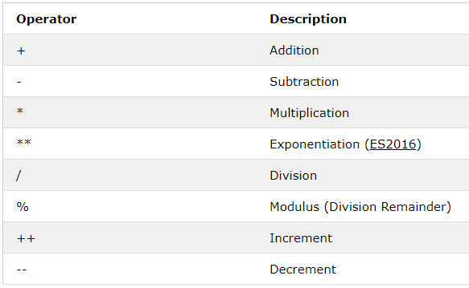
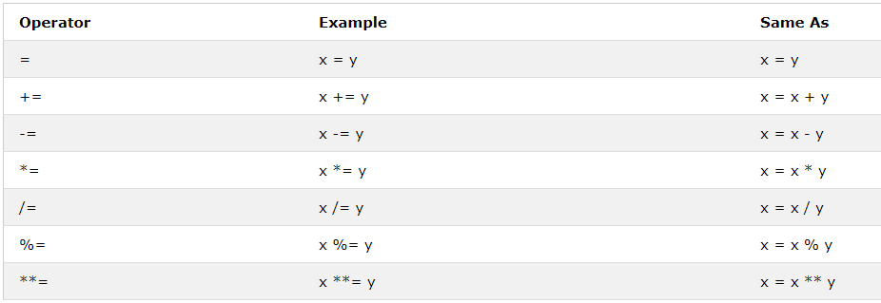
Operator & arithmetic

Slide 11
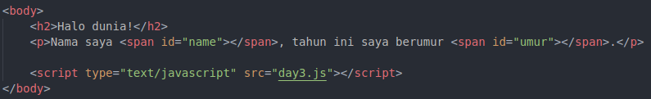
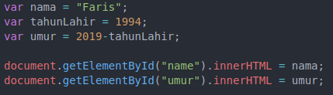
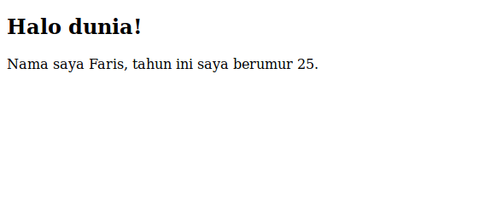

Slide 12
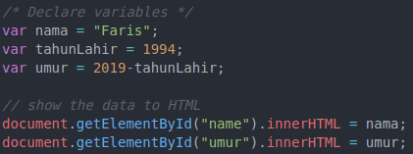
Comments in JS

Slide 13
Try it!
Create variable of your
Name
Year of Birth
Current temperature in Celsius
Calculate your age and current temperature in Fahrenheit
Show your name, age and current Fahrenheit temperature to html

Slide 14
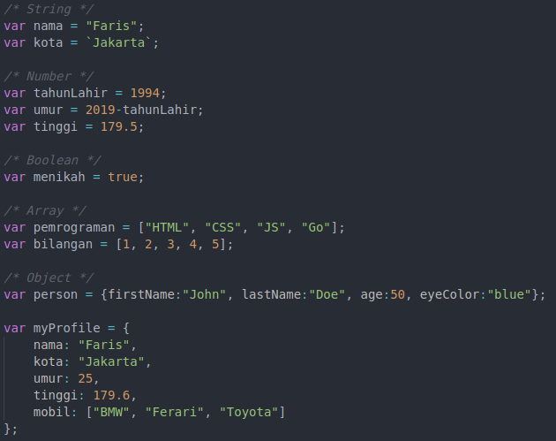
Data type

Slide 15
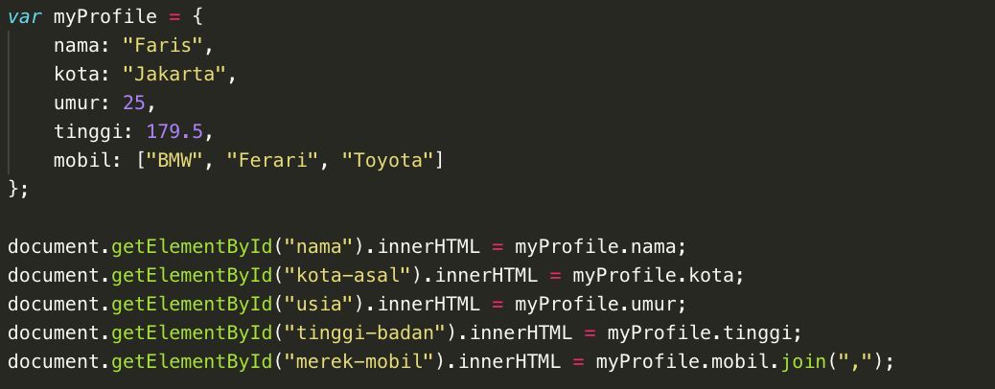
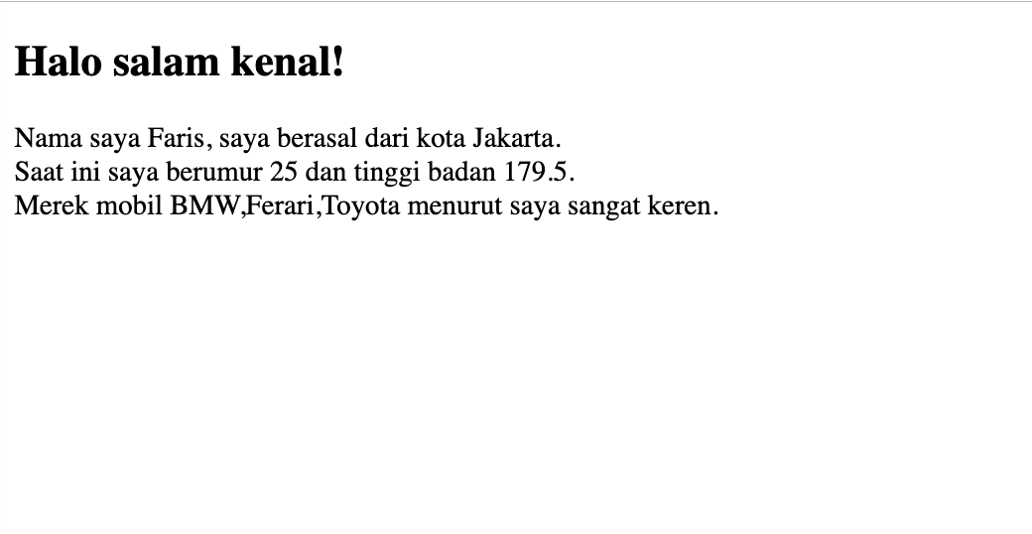
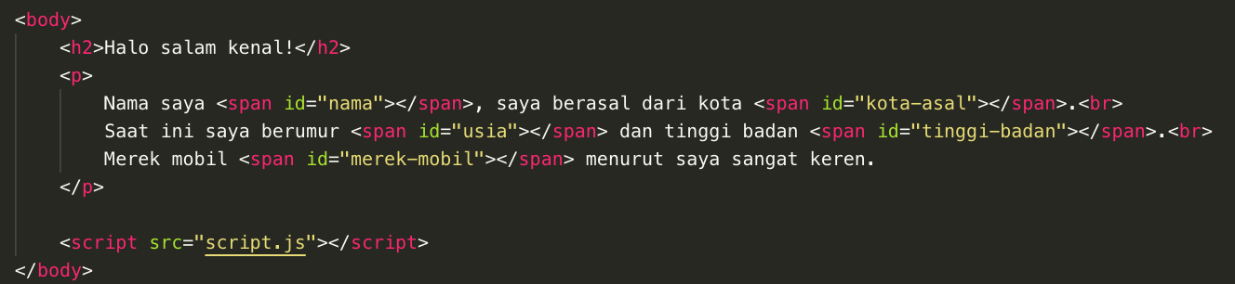
Object

Slide 16
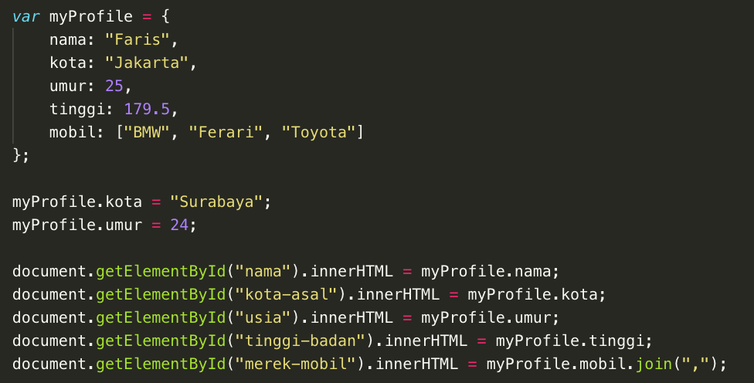
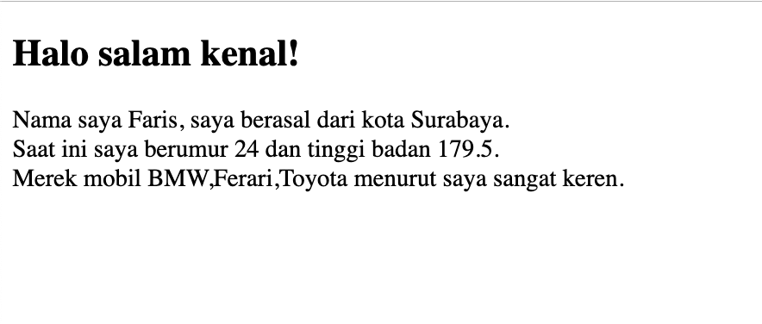
Assign object value

Slide 17
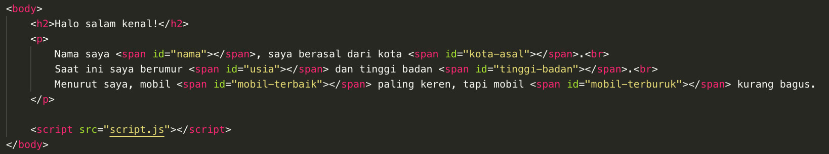
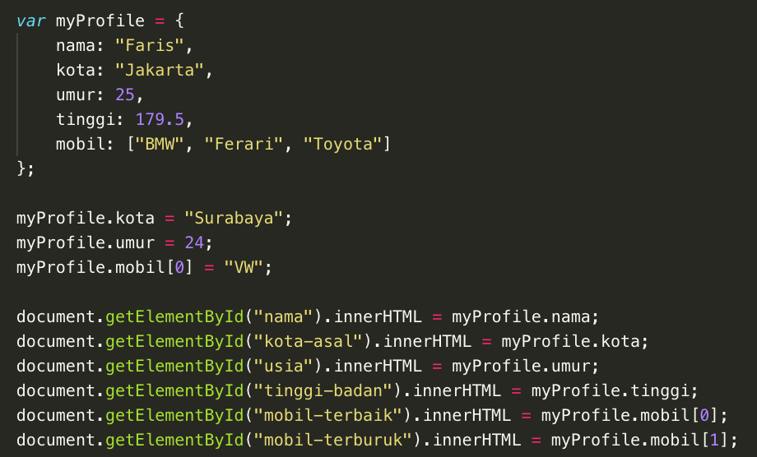
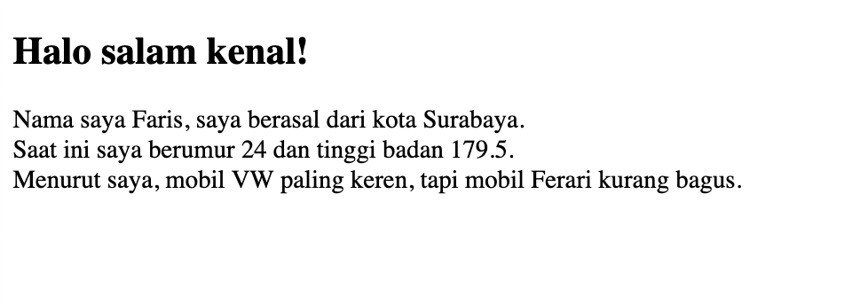
Array

Slide 18
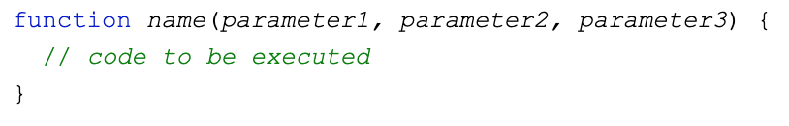
JS Function

Slide 19
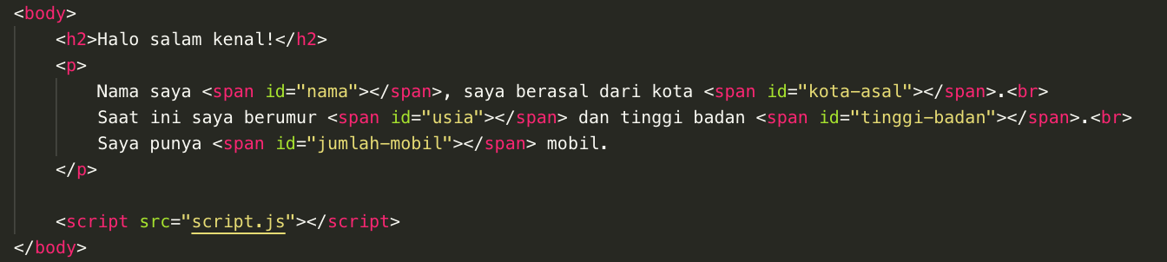
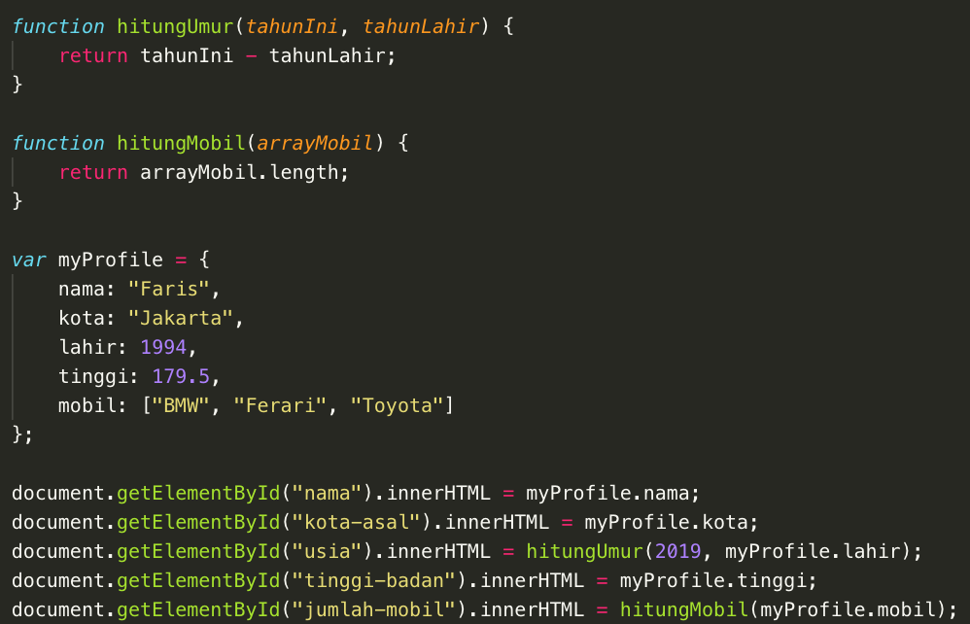
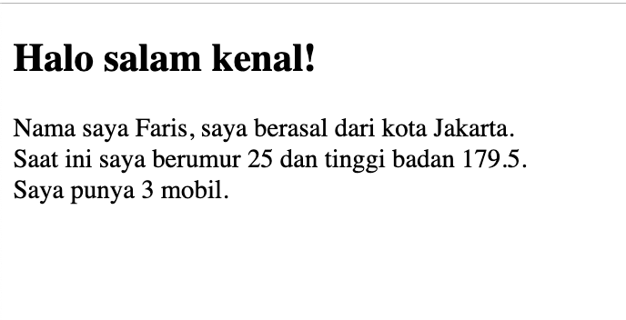
Function

Slide 20
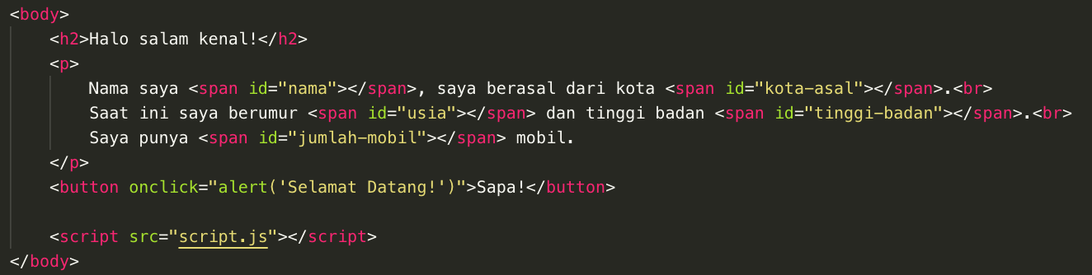
JS Event OnClick

Slide 21
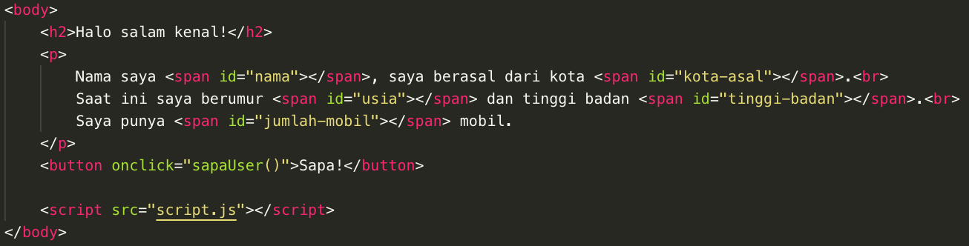
JS Event OnClick

Slide 22
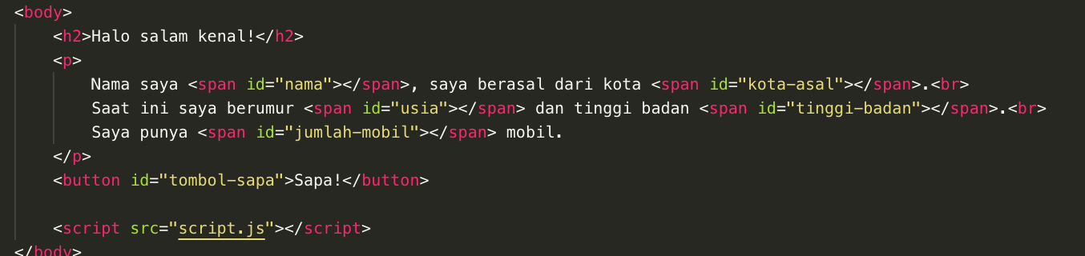
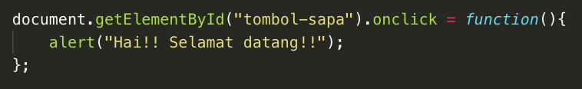
JS Event OnClick

Slide 23
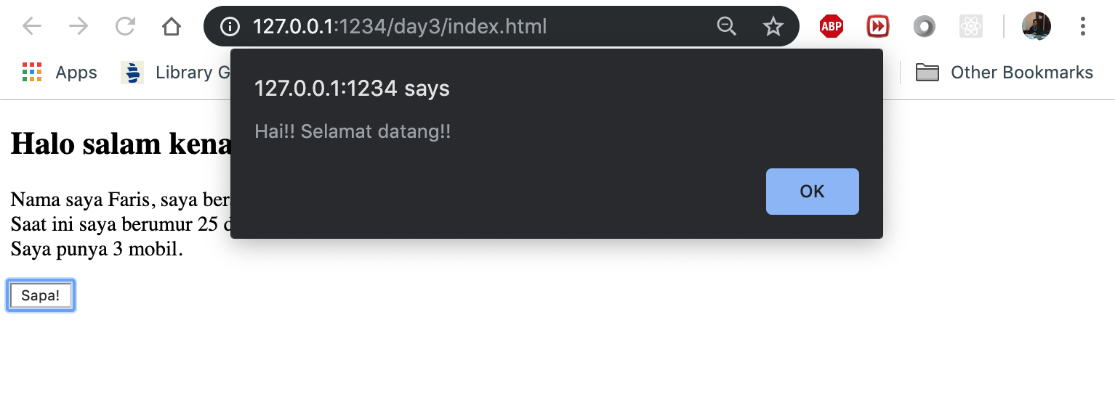

Slide 24
Practice!
Create a variable (object) of your profile
List all your stuffs in your bag into the variable
Create a function to count your stuffs
Show the variable to HTML (also the number of your stuffs and the list)
Create a button to change several value,
Set the button click to change the HTML value to the new one

Slide 25
“Our greatest weakness lies in giving up. the most certain way to success is always to try just one more time”
- Thomas Alpha Edison

